Slide 1
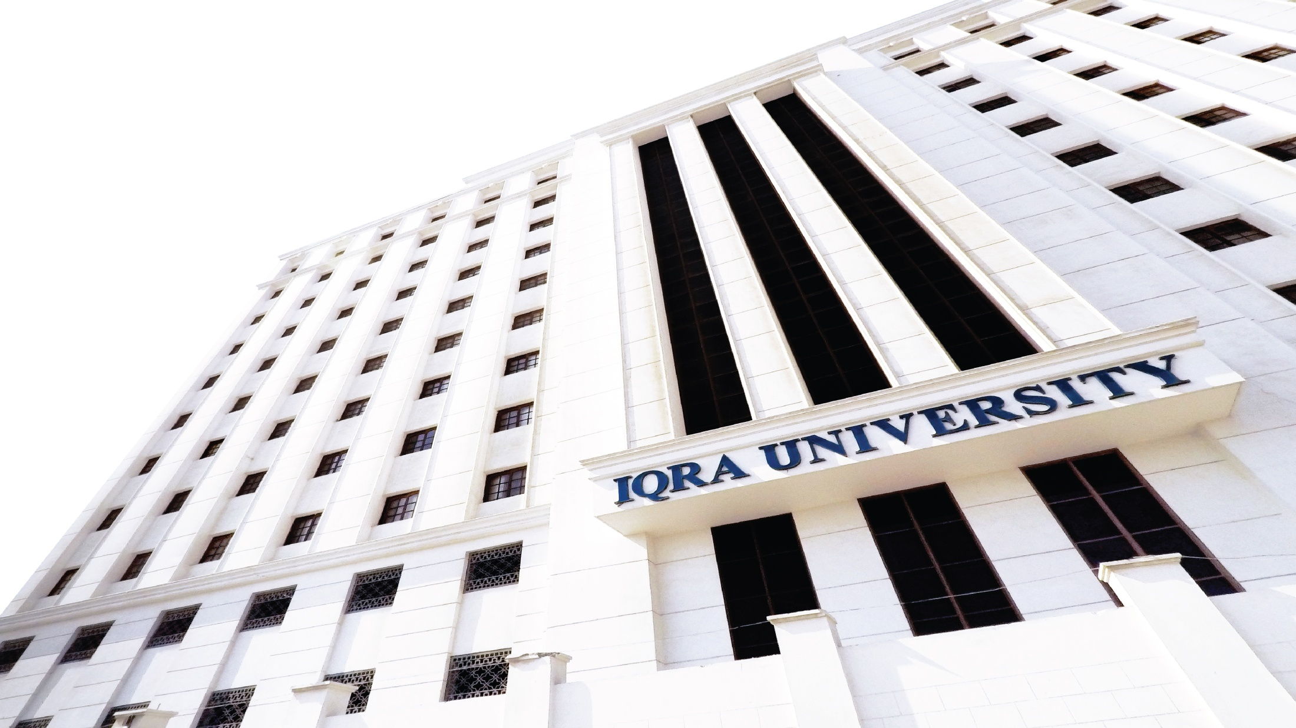

Information Security
Ali Ahmad Siddiqui

Slide 2
Welcome!!
Introduction to Computer Security

Slide 3
Computer Security
• Keep the computer in secure place
• Create login password
• Setup BIOS password
Software and Data Security inside Computer
• Use of Antivirus and Antispyware software
• Software Firewall
• Bitlocker

Slide 4
Key Factors in Data Security
• Confidentiality
• Integrity
• Availability
• Authenticity
• Non-Repudiation
Access Control

Slide 5
Confidentiality (Encryption)
• Protecting information from disclosure to unauthorized parties
• This type of access includes:
Printing
Displaying
Other forms of disclosure, including simply revealing the existing of an object
•Information like Bank account statements, credit card numbers, personal information should be kept in secret
•Key component of protecting information is Encryption

Slide 6
Integrity
• Protecting information from being modified by unauthorized parties
• Modification includes:
Writing
Changing
Changing status
Deleting and
Creating
• In online money transfer, if the information is tampered e.g. if the amount you sent is changed from $100 to $1000 then it could prove to be very costly
• Key component of protecting data is Hashing

Slide 7
Availability
• Ensure that the authorized parties are able to access the data all the time
• Denying access to information has become a very common attack nowadays. This is referred as DDoS attack
• Other factors may include incidents like power outage and natural disasters etc
• To ensure data availability, backups should be taken regularly, Disaster
Recovery (DR) procedures should be implemented

Slide 8
Authenticity
Authenticity is assurance that a message, transaction, or other exchange of information is from the source it claims to be from.
Key component for proving authenticity is digital signature

Slide 9
Non-repudiation
• Communication or any action that cannot be denied by the originator
• Sharing of Door Key cards and passwords should be strictly restricted

Slide 10
Access Control
Unauthorized users are kept out of the system
Access to authorized users can also be controlled using security policies

Slide 11
Thank you

